Slide 1
Overview of OOP
Object Oriented Development
with Java
(CT038-3-2 and Version VC1)
with Java classes

Slide 2
Topic & Structure of the lesson
Objects
Methods
Accessors and Mutators
Constructors
Static members
Visibility modifiers

Slide 3
Learning outcomes
At the end of this lecture you should be able to:
Understand the process of implementing Java classes
Understand and implement the concept of methods

Slide 4
Key terms you must be able to use
If you have mastered this topic, you should be able to use the following terms correctly in your assessments:
Objects
Classes
Dynamic Binding
Message Passing

Slide 5
Defining a class
In a Java program, everything is encapsulated in a class
A class is a user defined data type
Class defines the state and behavior of objects
Once class type has been defined, we can create “variables” of that type
These are known as instances of a class

Slide 6
Defining a class
The basic form of class definition is:
class classname [extends superclassname]
{
[ variable declaration; ]
[ methods declaration; ]
}

Slide 7
Adding variables
Instance variables are created whenever an object of the class is instantiated.
Example:
class Rectangle
{
int length;
int width;
}

Slide 8
Adding methods
A class without methods that operate on data has no “life”.
The objects created by such a class cannot respond to any messages.
Therefore add methods that are necessary for manipulating data contained in the class.

Slide 9
The general form of method declaration is:
type methodname (parameter-list)
{
method-body;
}

Slide 10
Example:
class Rectangle
{
int length;
int width;
void getData (int x, int y)
{
length = x;
width = y;
}
}

Slide 11
Example:
Assume we want to compute the area of the rectangle.
class Rectangle
{
int length, width;
void getData (int x, int y)
{
length = x;
width = y;
}
int rectArea( )
{
int area = length * width;
return (area);
}
}

Slide 12
Creating Objects
Creating an object is also referred to as instantiating an object.
Objects in Java are created using the new operator.
The new operator creates an object of the specified class and returns a reference to the object.

Slide 13
Example:
Rectangle rect1; // declare
rect1 = new Rectangle( ); // instantiate
OR
Rectangle rect1 = new Rectangle ( );

Slide 14
Accessing class members
The general form:
objectname. variable name
objectname. methodname (parameter-list);

Slide 15
Accessing instance variables: Example
The instance variables of the Rectangle class may be accessed and assigned values as follows:
rect1.length = 15;
rect1.width = 10;
rect2.length = 20;
rect2.width = 12;

Slide 16
Assigning values to instance variables
Another convenient way of assigning values to the instance variables is to use a method that is declared inside the class.
Example:
Rectangle rect1 = new Rectangle( ); //creating an object
rect1.getData(15,10); // calling the method using the object

Slide 17
Using instance variables
To compute the area of the rectangle represented by rect1 can be done in two ways.
int area1 = rect1.length * rect1.width;
OR
int area1 = rect1.rectArea();

Slide 18
Application of classes and objects
class Rectangle
{
int length, width;
void getData (int x, int y)
{
length = x;
width = y;
}
int rectArea( )
{
int area = length * width;
return (area);
}
}
(contd. on next page)

Slide 19
class RectArea {
public static void main (String args[ ]) {
int area1,area2;
Rectangle rect1 = new Rectangle();
Rectangle rect2 = new Rectangle();
rect1.length = 15;
rect1.width = 10;
area1 = rect1.length * rect1.width;
rect2.getData(20,12);
area2 = rect2.rectArea();
System.out.println(“Area1 = “ + area1);
System.out.println(“Area2 = “ + area2);
}
}

Slide 20
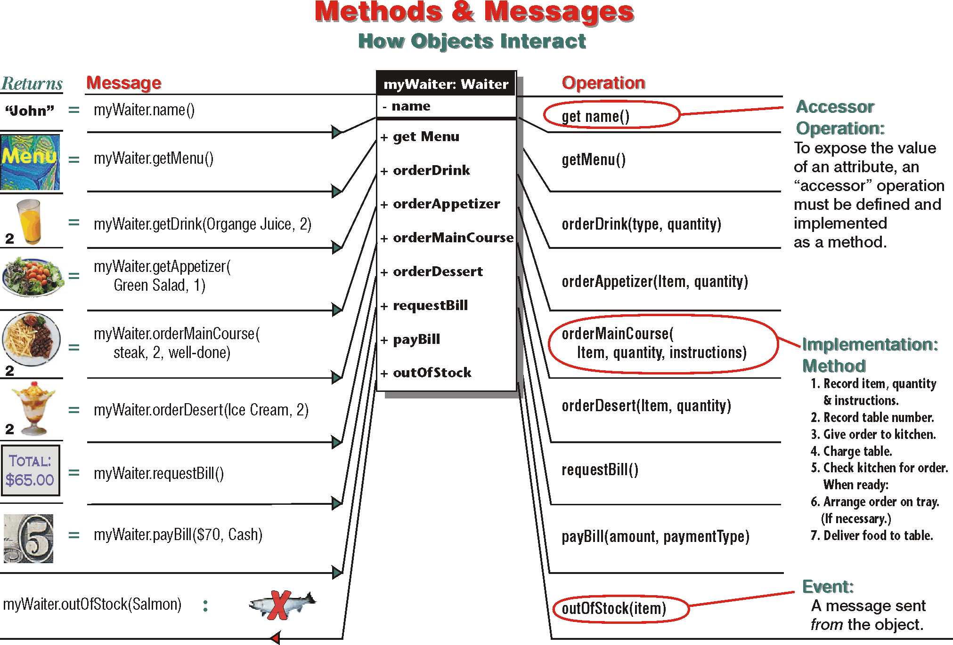

Slide 21
Accessor & Mutator Methods
Enforce data encapsulation
Hide data
Able to change how data is handled
Allows values set in attributes to be validated
Also known as setter and getter methods

Slide 22
Accessor & Mutator Methods
Accessor method:
Returns/obtains value of a private attribute/variable
Method name starts with the prefix “get”
Example:
public String getColor() {
return color;
}
To access the value:
Person Jerry = new Person();
System.out.println(Jerry.getColor());

Slide 23
Accessor & Mutator Methods
Mutator method:
Sets/assigns the value of a private attribute/variable
Method name starts with the prefix “set”
Example:
void setColor(String c) {
color = c;
}
To set the value:
Person Jerry = new Person();
Jerry.setColor(“Blue”);

Slide 24
Constructors
Java supports a special type of method called a constructor.
It enables an object to initialize itself when it is created.
A constructor has the same name as the class itself.
Do not have a return type because they return instances of the class.

Slide 25
Consider the Rectangle class again. Replace the getData method by a constructor.
class Rectangle
{
int length, width;
Rectangle (int x, int y) // constructor method
{
length = x;
width = y;
}
int rectArea( )
{
return (length * width);
}
}

Slide 26
Static Members
Used to define a member that is common to all the objects and accessed without using a particular object
member belongs to the class as a whole rather than the objects that were created from the class
Such members can be defined as follows:
static int count;
static int max (int x, int y);

Slide 27
Static Members contd.
static variables are often referred to as class variables
static methods are often referred to as class methods
static variables and static methods can be called without using objects - are called using class names

Slide 28
class MathOperation {
static float mul (float a, float b) {
return a*b; }
static float divide (float a, float b) {
return a/b; }
};
class MathApplication {
public static void main (String [] args) {
float a = MathOperation.mul (4.0, 5.0);
float b = MathOperation.divide(a, 2.0);
System.out.println (“b=“ +b);
}
}

Slide 29
Static Members contd.
Note:
Static methods are called using class names
No objects are created for use.
Restrictions:
They can only call other static methods.
They can only access static data.

Slide 30
Visibility modifiers
also known as access modifiers
are applied to the instance variables and methods to restrict the access to these variables and methods from outside the class
3 types:
public
private
protected

Slide 31
public Access
any variable or method that is visible to all classes outside this class
declared as:
public int number;
public void sum ( )
{
...................
}
has the widest possible visibility and accessible everywhere
classes usually define methods to be public so that the client program (eg. main method) is able to “set” or “get” private instance variables

Slide 32
friendly Access
when NO access modifier is specified, the member defaults to a limited version of public accessibility known as friendly level of access
makes fields visible in all classes but only in the same package but not in other packages
a package
is a group of related classes stored separately

Slide 33
protected Access
visibility level lies between the public access and friendly access
makes the fields visible not only to all classes and subclasses in the same package but also to subclasses in other packages
non-subclasses in other packages cannot access the protected members

Slide 34
private Access
private access fields
have highest degree of protection
are accessible only within their own class
cannot be inherited by subclass
is not accessible in subclass
private access methods
behaves like a method declared as final
prevents the method from being subclassed
cannot override a non-private method in a subclass and then make it private
Data hiding

Slide 35
Class Diagram revisited
private
parameters
The class name
The structure
(attributes)
The behavior
(operations)
Professor
- name : String
- employeeID : int
- hireDate : String
- status : String
- discipline : String
- maxLoad : float
+ submitFinalGrade(grade: float) : void
+ acceptCourseOffering()
+ setMaxLoad(load : float) : void
+ takeSabbatical() : int
+ teachClass() : String
public
return type

Slide 36
Class Diagram revisited
Professor
class Professor {
private String name;
private int employeeID;
private String hireDate;
private String status;
private String discipline;
private float maxLoad;
public void submitFinalGrade(float grade) {}
public void acceptCourseOffering() {}
public void setMaxLoad(float load) {}
public int takeSabbatical() {}
public String teachClass() {}
}
- name : String
- employeeID : int
- hireDate : String
- status : String
- discipline : String
- maxLoad : float
+ submitFinalGrade(grade: float) : void
+ acceptCourseOffering()
+ setMaxLoad(load : float) : void
+ takeSabbatical() : int
+ teachClass() : String

Slide 37

Quick Review Questions
How to define a class?
How to define an object?
How to create and call variables?
How to create and call methods
Accessors and Mutators
Access Specifiers
Class Diagram

Slide 38
Summary of Main Teaching Points
Class
Objects
Variables
Methods
Accessors and Mutators
Access Specifiers

Slide 39
Question and Answer Session
Q & A

Slide 40
Next Session
Inheritance
Single inheritance
Multiple inheritance
Multi-level inheritance
Inheriting Methods

